Slide 1
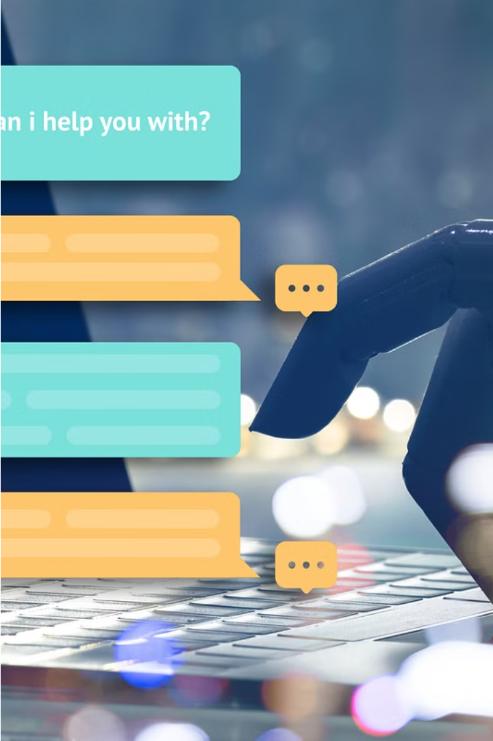
Combating Boredom with a Chatbot
Boredom can strike at the most inconvenient times, but a chatbot designed to combat dullness could be your new best friend. This engaging AI assistant is here to provide personalized suggestions and activities to keep you entertained and stimulated.
By
Varun Ameta (20ETCCS113)
Dev Bikaneria (20ETCCS028)

Slide 2
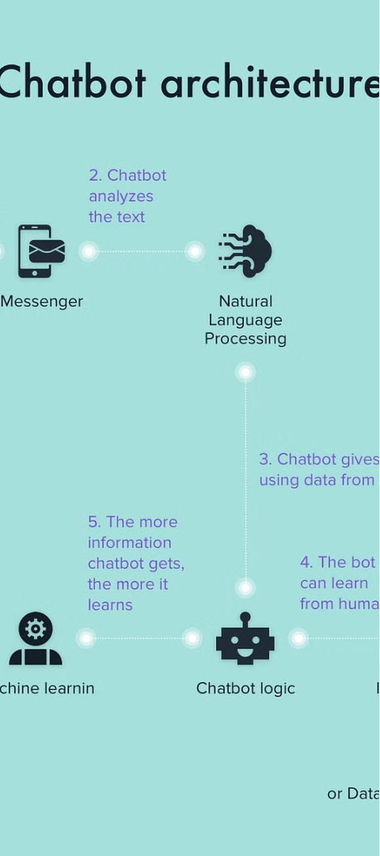
What is a Boredom Chatbot?
1
AI-Powered Companion
2
Personalized Recommendations
A boredom chatbot is an intelligent software program powered by artificial intelligence that aims to alleviate feelings of monotony and disengagement.
By gathering information about your interests, location, and preferences, the chatbot can suggest customized activities and entertainment to match your unique needs.
3
Interactive Experience
Through natural language processing, the chatbot engages in a conversational dialogue, making the experience feel more personal and dynamic.

Slide 3
Why a Boredom Chatbot Matters
Combating Isolation
Improving Mental Health
Enhancing Productivity
In today's digital age, many people struggle with feelings of isolation and disconnection. A boredom chatbot can provide a sense of companionship and engagement.
By providing stimulating activities and suggestions, a boredom chatbot can help individuals stay focused, energized, and productive throughout the day.
Prolonged boredom can negatively impact mental well-being, leading to depression, anxiety, and decreased motivation. A chatbot can help break this cycle.

Slide 4
Key Features of a Boredom Chatbot
Personalized Recommendations
Weather-Based Suggestions
The chatbot gathers information about the user's interests, location, and preferences to suggest tailored activities and entertainment.
Integrating weather data, the chatbot can provide suggestions that align with the current or forecasted weather conditions.
Engaging Conversation
Mood Tracking
Through natural language processing, the chatbot can engage in fluid conversations, making the experience feel more interactive and personal.
The chatbot can monitor the user's mood and adjust its responses and suggestions accordingly to better address their needs.

Slide 5



Technologies Powering the Boredom Chatbot
OpenAI API
Weather API
Python Flask
Leveraging the powerful language models of the OpenAI API, the chatbot can understand natural language and generate personalized responses.
Integrating a weather API, the chatbot can provide suggestions based on current and forecasted weather conditions.
The chatbot is built using the Python Flask framework, which provides a robust and flexible web application development platform.

Slide 6
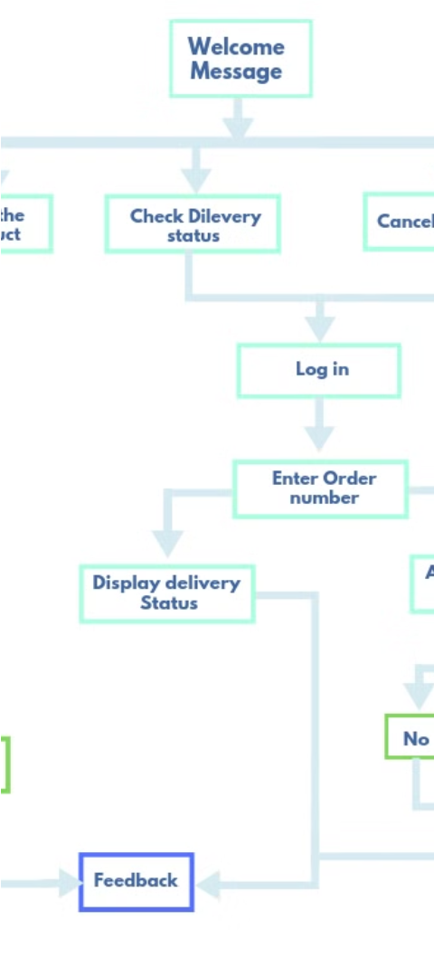
How the Boredom Chatbot Works
1
User Inputs
The chatbot collects information from the user, such as email, name, location, number of people, favorite activities, and indoor/outdoor preferences.
2
Personalized Analysis
Using the user's inputs, the chatbot leverages its AI capabilities to analyze the data and generate personalized recommendations.
3
Suggestion Delivery
The chatbot presents the user with a tailored list of activities, events, or entertainment options based on their unique profile and preferences.

Slide 7




Benefits of Using a Boredom Chatbot
Customized Experiences
The chatbot's personalized suggestions ensure that users receive activities and entertainment that truly resonate with their interests and needs.
Improved Mood
By keeping users engaged and entertained, the chatbot can help alleviate feelings of boredom, loneliness, and depression.
Enhanced Productivity
The chatbot's ability to provide stimulating suggestions can help users stay focused, motivated, and productive throughout the day.

Slide 8
Potential Drawbacks of a Boredom Chatbot
Dependence Concerns
Accuracy Limitations
Privacy Risks
Overreliance on the chatbot for entertainment and companionship could lead to decreased social interaction and isolation.
The chatbot's suggestions may not always be perfectly tailored to the user's needs, leading to suboptimal recommendations.
The chatbot's collection of personal data raises concerns about data privacy and security, which must be addressed.

Slide 9

Enhancing the Chatbot Experience
Ongoing Improvements
1
Regular updates and enhancements to the chatbot's algorithms and features can improve the accuracy and relevance of its suggestions.
2
Multimodal Interactions
Incorporating voice commands, image recognition, and other interactive features can make the chatbot experience more intuitive and engaging.
Integrated Ecosystems
3
Seamless integration with other applications and services can further expand the chatbot's capabilities and provide a more holistic user experience.

Slide 10

Conclusion
A boredom chatbot can be a valuable tool in the modern world, offering personalized suggestions and activities to keep users entertained, engaged, and productive. By leveraging the power of AI and integrating with various technologies, these chatbots can provide a unique and enriching experience that helps combat the negative impacts of boredom and loneliness.

